Slide 1
“My last duchess”
Robert browning, poet
Published in 1842

Slide 2
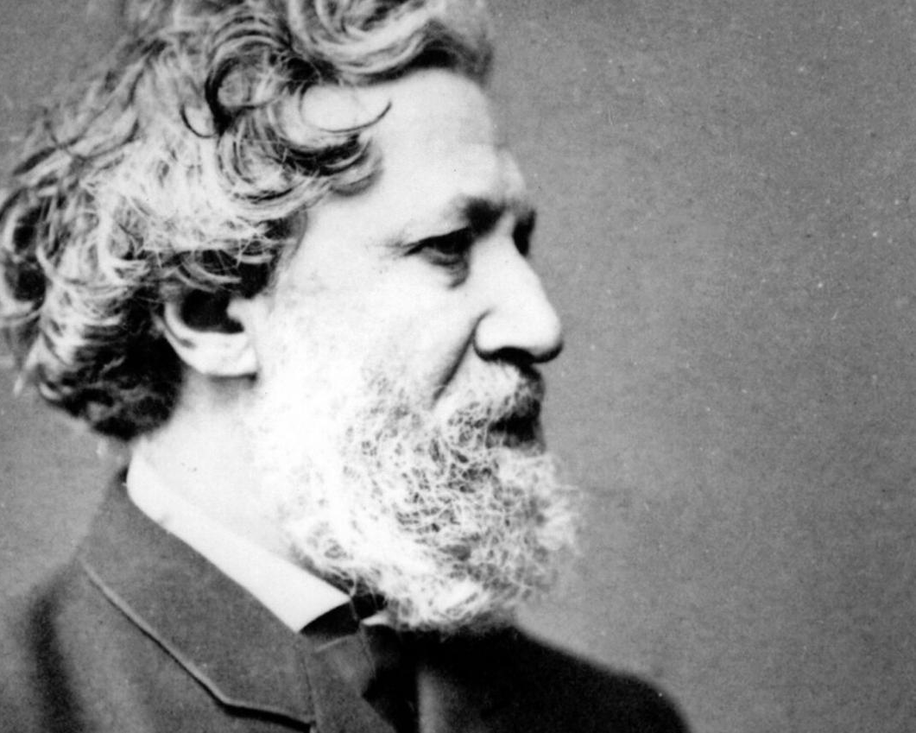
Robert Browning
7 May 1812 – 12 December 1889
Married to another (great) poet Elizabeth Barrett Browning
Well-known poetry collections include: Dramatic Lyrics, Men and Women, The Ring and the Book, and Dramatis Personae

Slide 3
Terms to know Dramatic monologue Ekphrasis
Ekphrasis
“Description” in Greek. An ekphrastic poem is a vivid description of a scene or, more commonly, a work of art. Through the imaginative act of narrating and reflecting on the “action” of a painting or sculpture, the poet may amplify and expand its meaning. A notable example is “Ode on a Grecian Urn,” in which the poet John Keats speculates on the identity of the lovers who appear to dance and play music, simultaneously frozen in time and in perpetual motion

Slide 4
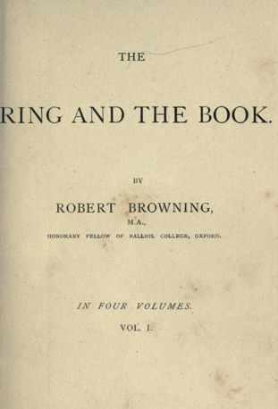
Dramatic monologue M.H. Abrams notes the following three features of the dramatic monologue as it applies to poetry:
1. The single person/SPEAKER, (not the poet) utters the speech that makes up the whole of the poem, in a specific situation at a critical moment
2. This person addresses and interacts with one or more other people; but we know of the auditors' presence, and what they say and do, only from clues in the discourse of the single speaker.
3. The main principle controlling the poet's choice and formulation of what the lyric speaker says is to reveal to the reader, in a way that enhances its interest, the speaker's temperament and character

Slide 5
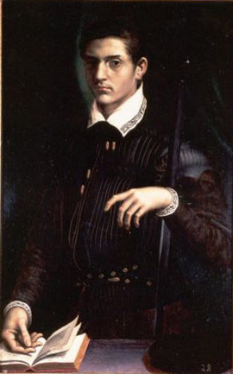
Duke of Ferrara 1533-1597

Slide 6
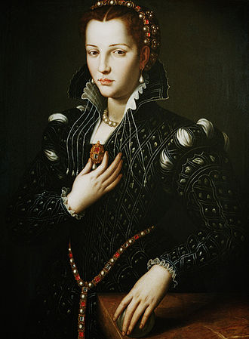
Lucrezia de' Medici, Duchess of Ferrara 14 February 1545 – 21 April 1561

Slide 7
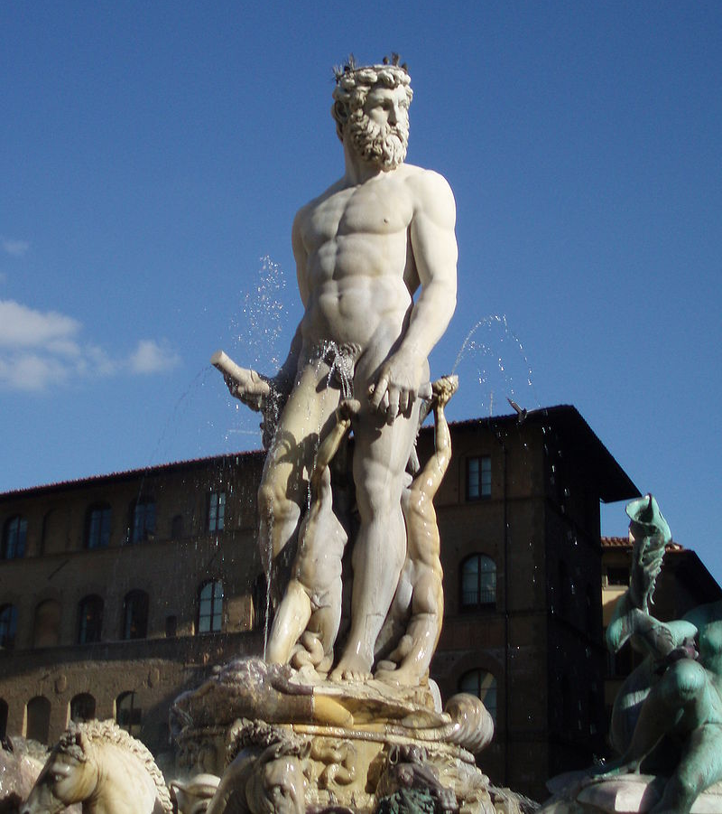
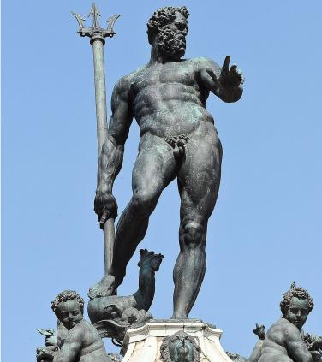
Neptune
Italian Renaissance Representations

Slide 8
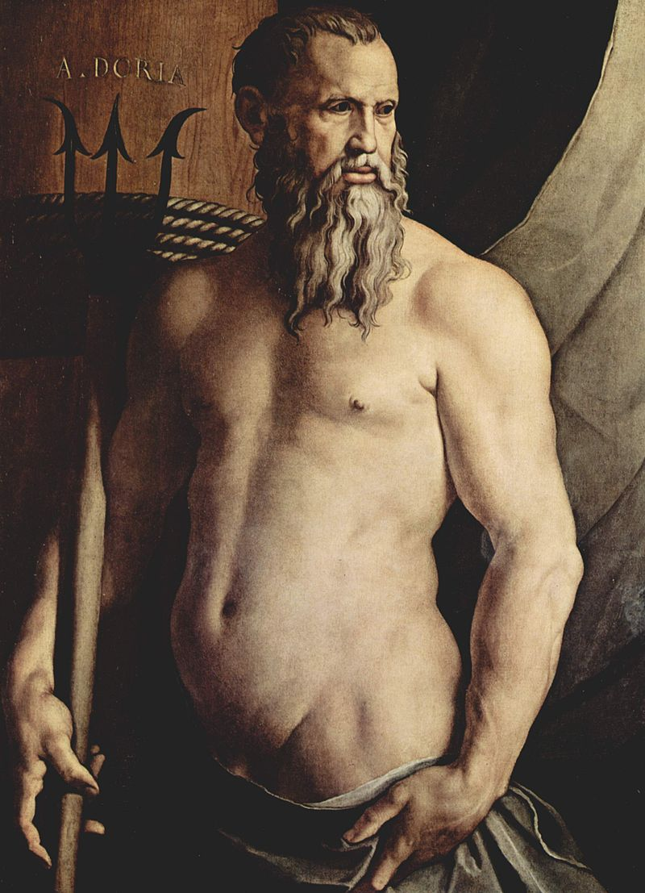
Bronzino’s depiction of Neptune in the 16th century

Slide 9
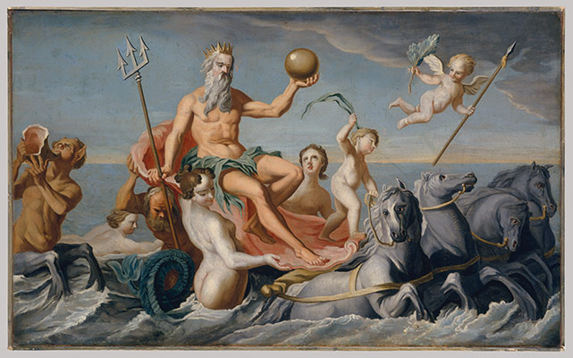

Slide 10
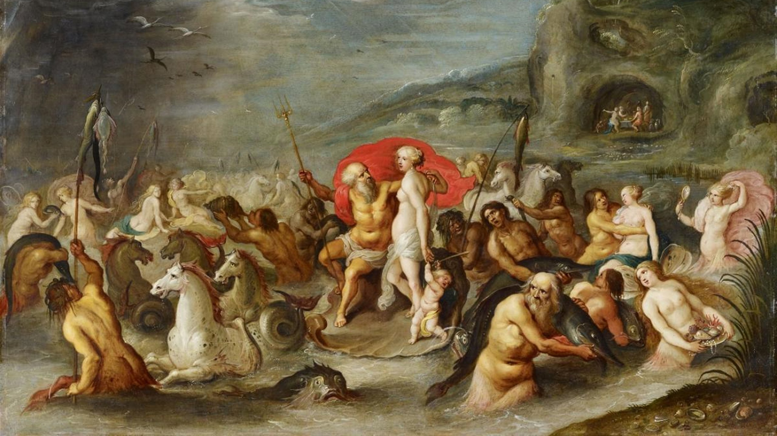

Slide 11
